Slide 1
THE GEORGE WASHINGTON UNIVERSITY
Columbian College of Arts and Sciences | M.S. Data Science | Spring 2026
Global AI Governance Narratives
A Spatial NLP Analysis of Academic and Policy Discourse
Tambudzai G. Charumbira | Joshua Gray
Mapping how 41,067 peer-reviewed publications and 35 national AI strategy documents frame governance priorities across regions, institutions, and time — using BERTopic and zero-shot stance classification.

Slide 2
Background & Motivation
The Problem
Why Now?
AI governance is shaped by vast academic research and national policy frameworks — yet no systematic, spatially grounded map exists of how governance concerns are framed across regions.
Existing work describes where research originates, but not:
How AI governance concerns are substantively framed
Which risks are foregrounded by different regions
Whether AI is positioned as threat or opportunity
How academic and policy discourse align
ChatGPT's release (Nov 2022) compressed a decade of gradual regulatory development into just a few years — forcing governments, researchers, and institutions to respond rapidly.
The EU AI Act (2024) introduced the world's first comprehensive AI regulatory framework, but its global reach and actual influence remain poorly understood.
Regional power asymmetries in AI research raise questions about whose governance concerns shape the global conversation.
Global AI Governance Narratives | Charumbira & Gray | GWU CCAS | Spring 2026

Slide 3
Research Questions & Objectives
RO1
What are the dominant AI governance themes, how have they evolved over time, and are they framed as risks, opportunities, or balanced concerns?
Themes & Framing
RO2
How is AI governance discourse distributed spatially across world regions and contributing institutions, and what patterns of specialization exist?
Spatial Distribution
RO3
How do academic and policy corpora compare in terms of governance topic coverage, and where do significant knowledge-policy gaps exist?
Academic vs. Policy Alignment
Global AI Governance Narratives | Charumbira & Gray | GWU CCAS | Spring 2026

Slide 4
Data Overview
41,067
138
35
40,968
Scopus AI publications
(2015–2025)
Countries represented
National AI strategy
documents
Institutions geocoded
(99.96% coverage)
Academic Corpus
Policy Corpus
Source: Scopus — peer-reviewed AI publications at the intersection of governance, ethics, risk, regulation, policy, fairness, accountability, and transparency
Pre-ChatGPT (2015–2021): n = 8,088
Post-ChatGPT (2022–2025): n = 32,979
7.8% of sampled AI publications (n= 3,186) are governance related
Records with <50 abstract words excluded after deduplication
Source: OECD AI Policy Observatory + official government portals
35 national/international AI strategy docs & frameworks
Regions: North America, Europe, Asia-Pacific, Latin America, Africa & Middle East + intl. bodies
Chunked into 500-word segments (50-word overlap) → 1,557 chunks
Global AI Governance Narratives | Charumbira & Gray | GWU CCAS | Spring 2026

Slide 5
Methodology
1
Embedding Model Selection
2
Stage 1 — BERTopic
Benchmarked all-MiniLM-L6-v2, all-mpnet-base-v2, and paraphrase-multilingual-MiniLM-L12-v2 on coherence, diversity & outlier rate. Selected all-MiniLM-L6-v2 (coherence 0.716, diversity 0.747).
UMAP (n_neighbors=15, n_components=10) + HDBSCAN (min_cluster_size=50) → 46 topics. 53% of papers fell into a generic catch-all cluster.
3
Stage 2 — Hierarchical Decomposition
4
Governance Relevance Scoring
Second BERTopic pass on catch-all cluster (min_cluster_size=15) → 88 sub-topics. Final inventory: 133 topics across both stages.
Expert coding on 0–1 scale aligned with OECD AI Principles, EU AI Act risk categories & UNESCO Ethics Recommendation. Topics ≥0.5 → 21 governance topics (3,186 papers, 7.8%).
5
Zero-Shot Stance Classification
6
Geographic Attribution & Co-authorship
Facebook/Bart-Large-MNLI applied to 3,186 abstracts. Labels: risk-focused, opportunity-focused, balanced. Confidence <0.45 → balanced (conservative).
First-author institution metadata geocoded via OpenStreetMap Nominatim (99.96% coverage). 116,351 institution-pair edges; 2,410 international country-pair edges constructed.
Global AI Governance Narratives | Charumbira & Gray | GWU CCAS | Spring 2026

Slide 6
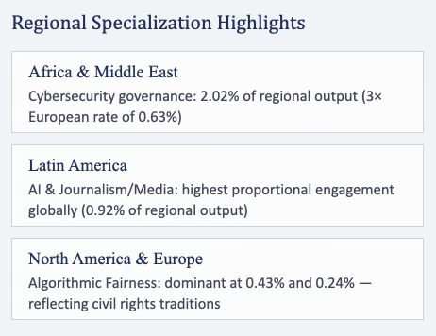
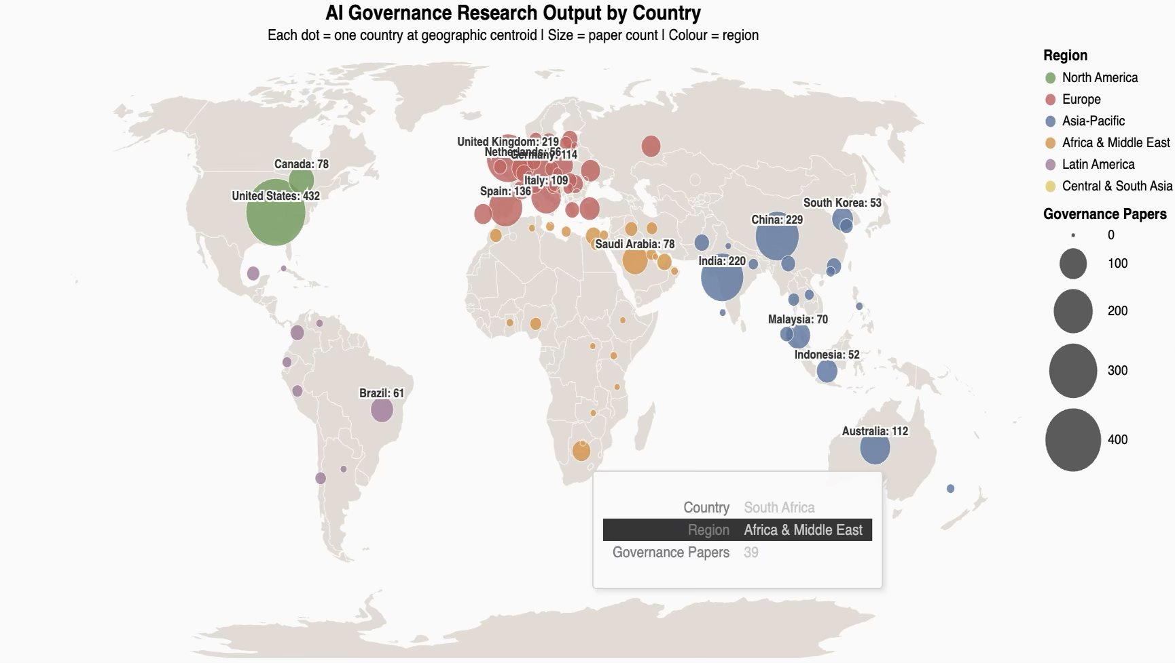
Results: Spatial Distribution
Global AI Governance Narratives | Charumbira & Gray | GWU CCAS | Spring 2026

Slide 7
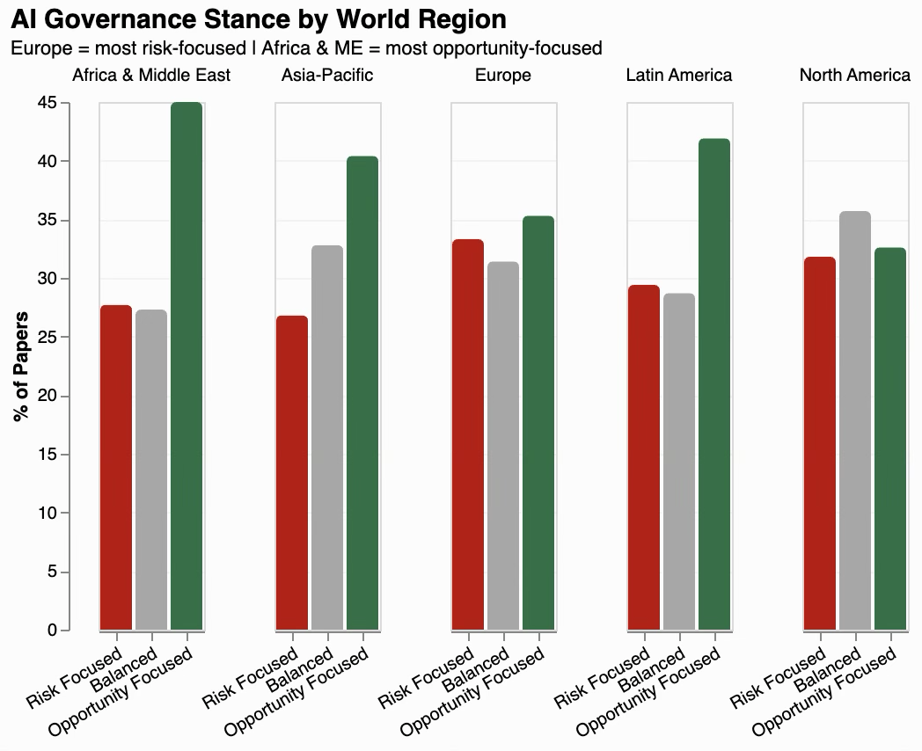
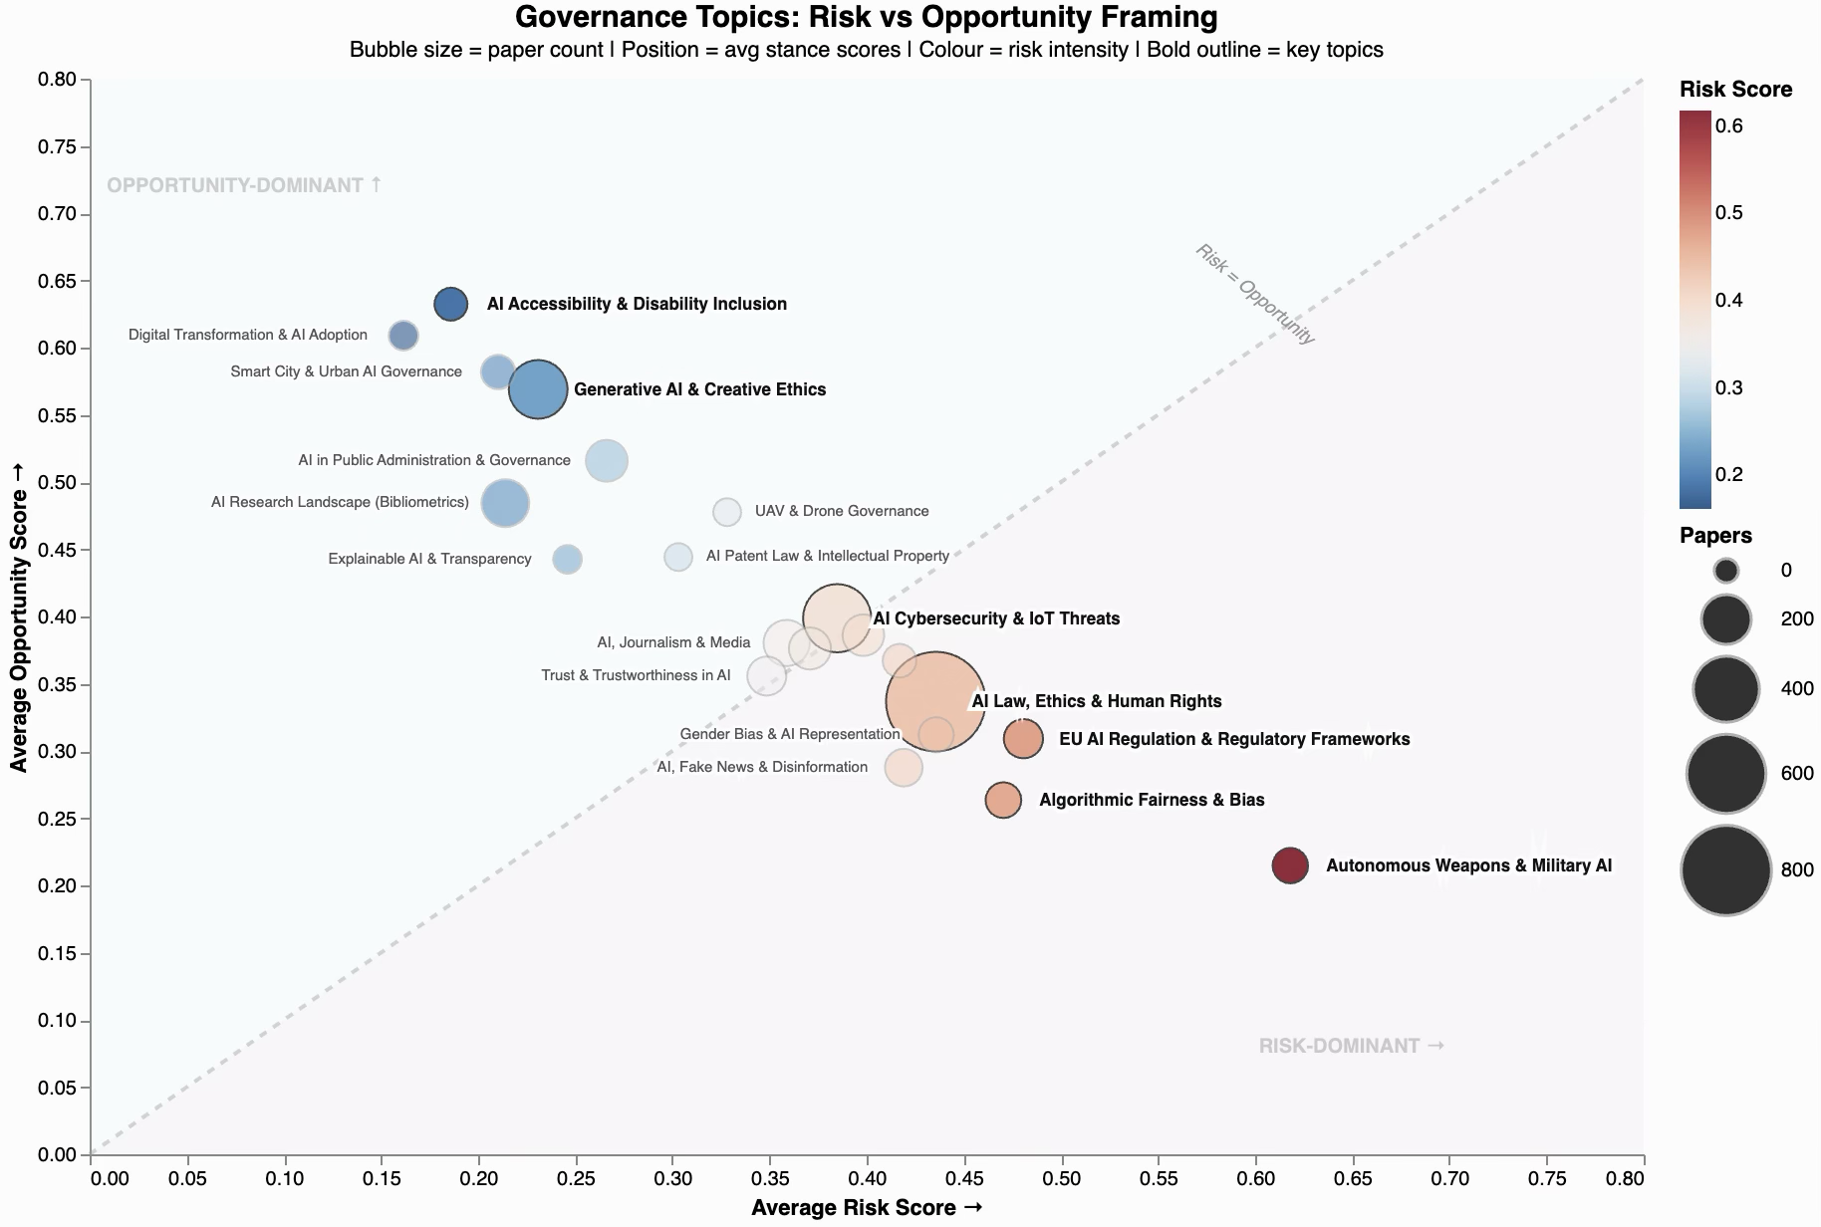
Results: Emerging Topics & Framing
4
Autonomous Weapons is the most risk-dominated topic (72.9% risk). AI Accessibility is the most opportunity-framed (78.8%). Topics cluster into distinct risk and opportunity zones governance framing is not uniform.
Four of five regions are opportunity-dominant. North America is the only balanced-dominant region. Africa & Middle East frames governance most optimistically (45%) despite its cybersecurity focus.
6
Global AI Governance Narratives | Charumbira & Gray | GWU CCAS | Spring 2026

Slide 8
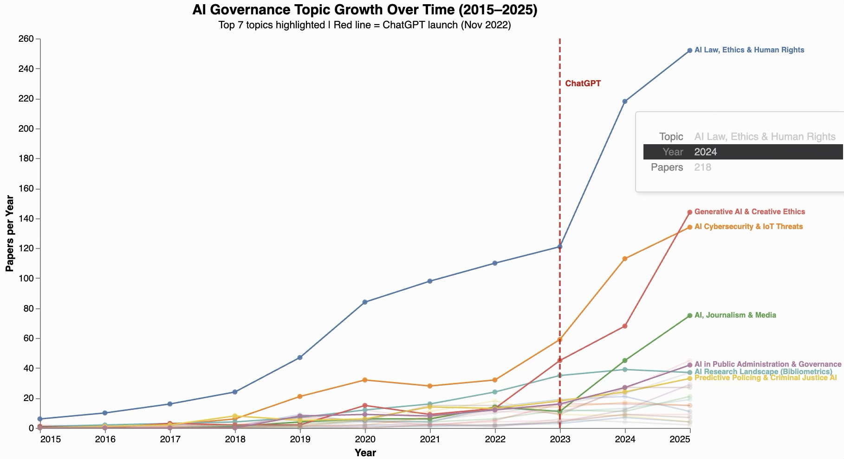
Results: Temporal Analysis
The ChatGPT Paradox
Governance volume surged post-ChatGPT, yet framing shifted toward opportunity — suggesting scholars reoriented toward institutional design rather than problem identification.
Highest Absolute Growth by Topic (Pre→Post ChatGPT)
+706%
AI & Journalism / Media
+617%
Trust & Trustworthiness in AI
+367%
Gender Bias & AI Representation
+354%
Algorithmic Fairness & Bias
Global AI Governance Narratives | Charumbira & Gray | GWU CCAS | Spring 2026

Slide 9
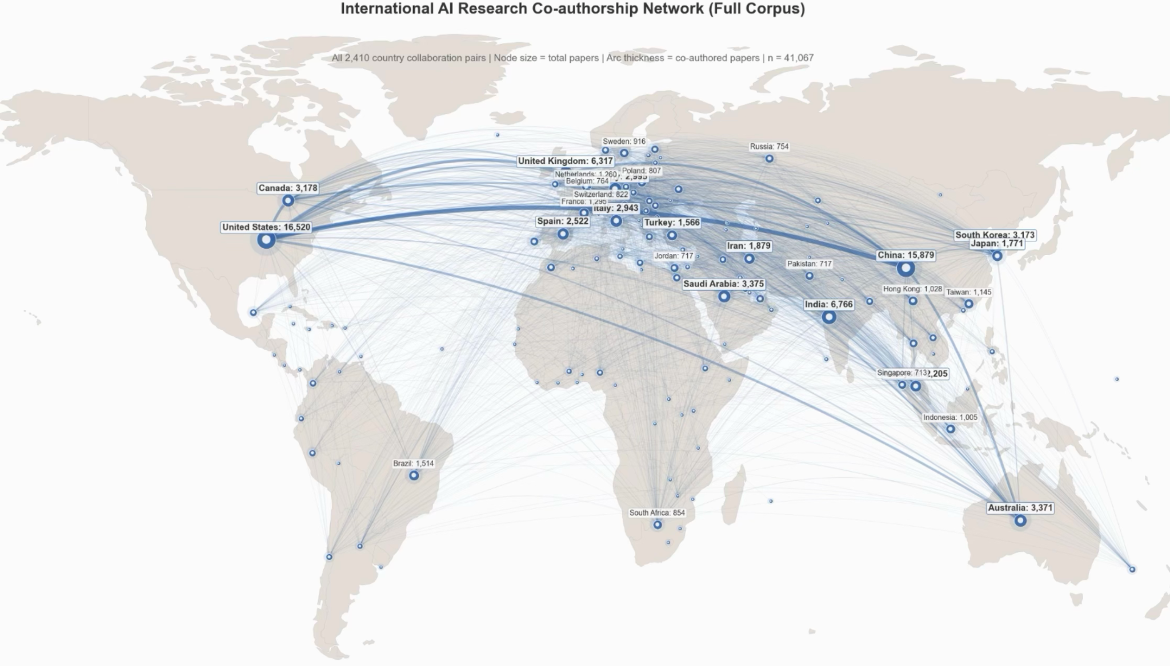
Results: Country-Level Paper Collaboration
Top Bilateral Partnerships
China–United States: 3,691 co-authored papers United Kingdom–United States: 2,336 Canada–United States: 2,245
Collaboration Gap
The US appears in the top 6 bilateral pairs globally. Cross-regional collaboration involving Africa, the Middle East, or Latin America remains comparatively limited — the densest arcs connect North America, Europe, and Asia-Pacific.
Global AI Governance Narratives | Charumbira & Gray | GWU CCAS | Spring 2026

Slide 10
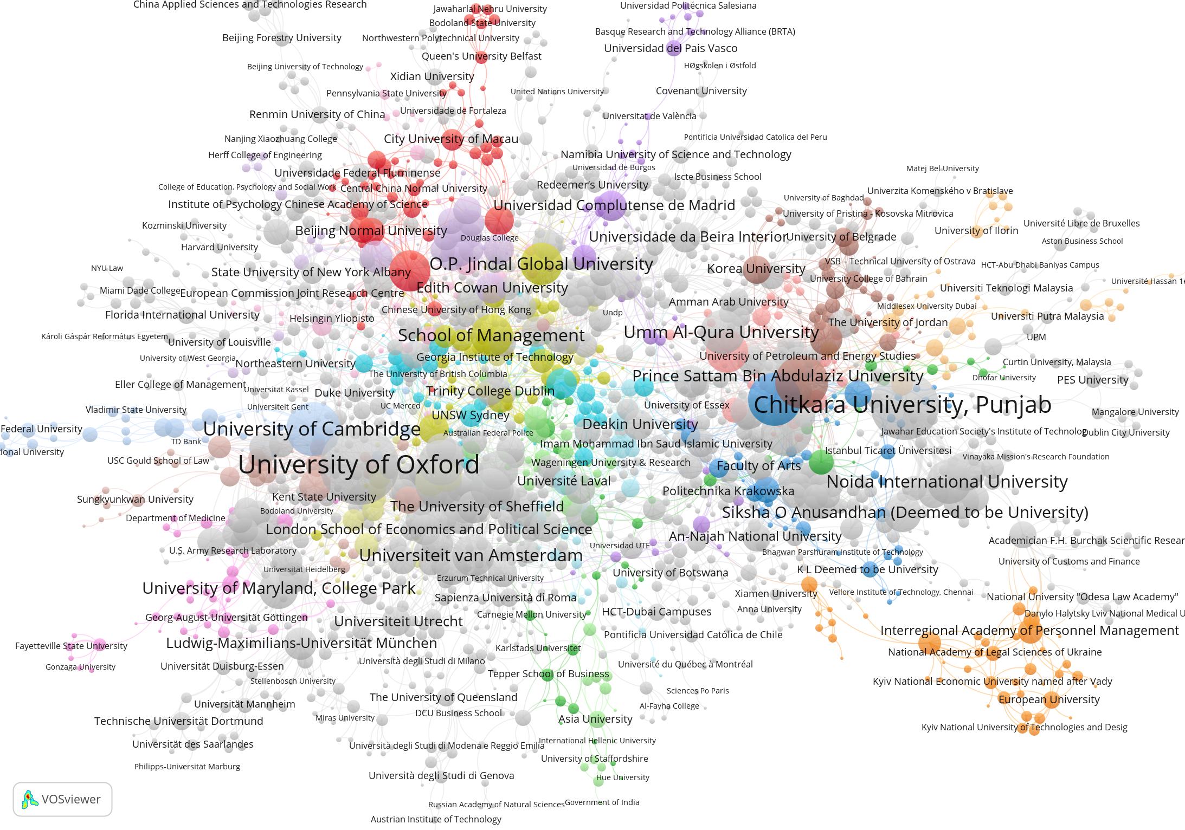
Results: Institution Co-authorship Network
Top Contributing Institutions
Institutional Network Highlights
Europe
University of Oxford and University of Cambridge are the most central European nodes, with dense connections to partners across regions. Universidad Complutense de Madrid, Universiteit van Amsterdam, and London School of Economics also feature as well-connected hubs.
Asia
Chitkara University, Punjab and O.P. Jindal Global University are the most prominent Asian nodes. Saudi institutions — Umm Al-Qura University, Prince Sattam Bin Abdulaziz University — form a distinct, highly interconnected cluster, reflecting strong intra-regional collaboration.
North America
University of Maryland, College Park is the most visible North American node in the network. North American institutions appear more often as collaborative partners to European and Asian hubs than as dominant nodes themselves.
Global AI Governance Narratives | Charumbira & Gray | GWU CCAS | Spring 2026

Slide 11
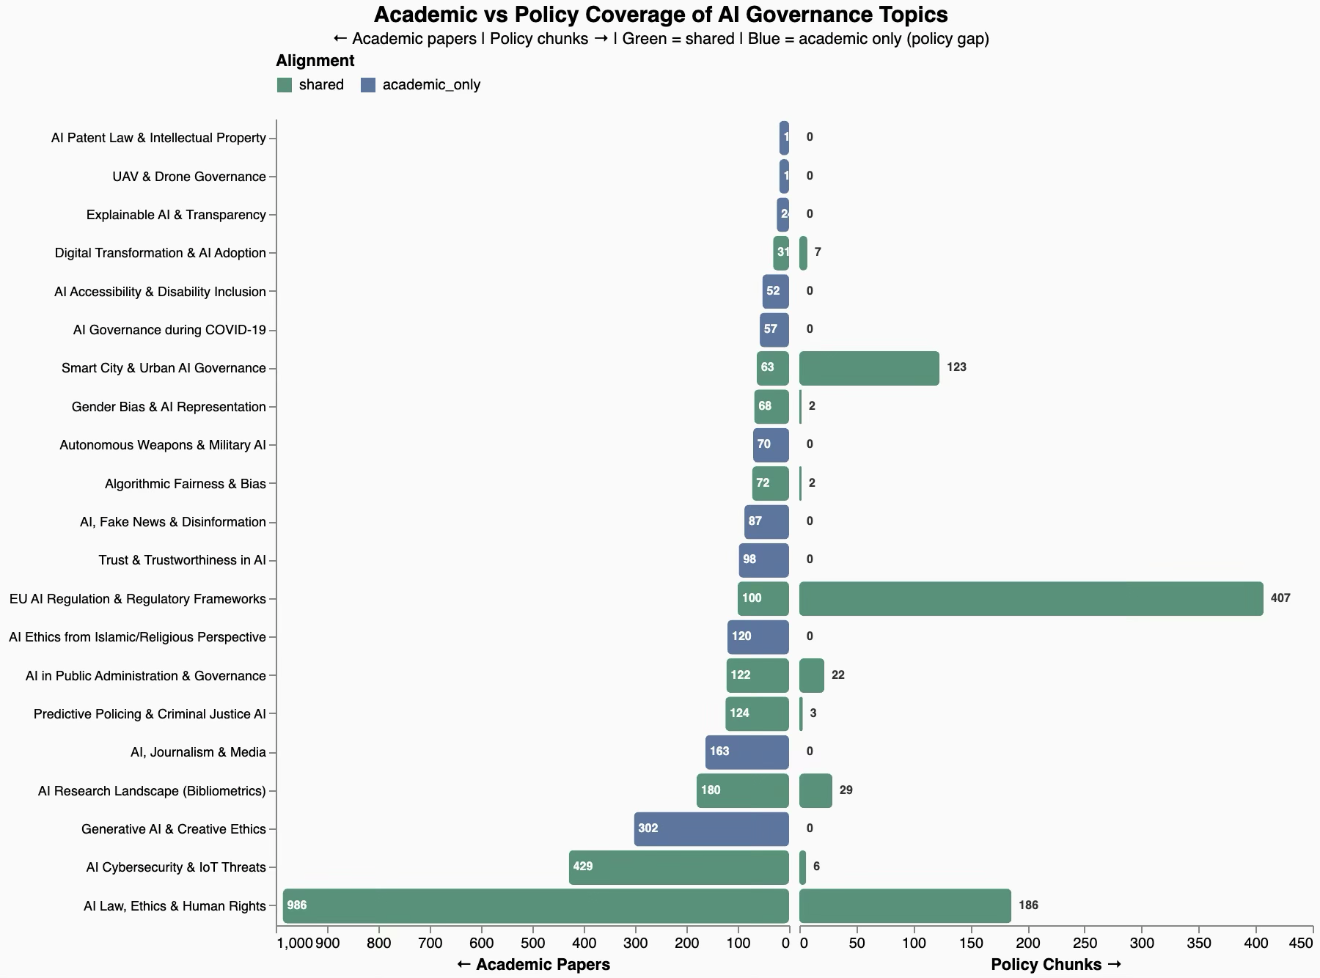
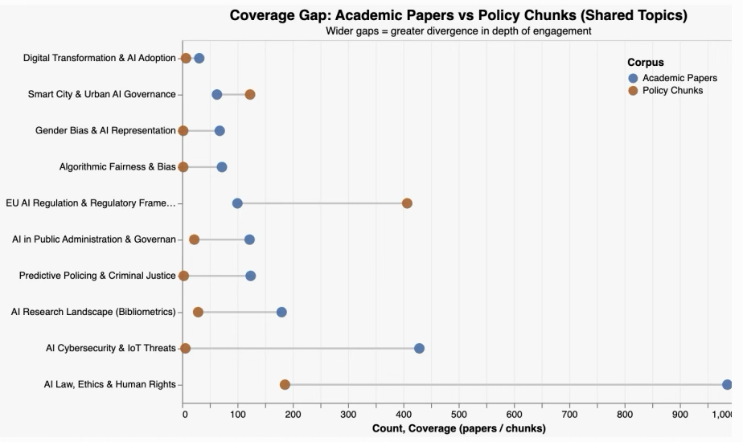
Results: Governance Topics & Academic-Policy Alignment
7.8%
64.7%
of AI publications
address governance
of governance corpus
in top 5 topics
Global AI Governance Narratives | Charumbira & Gray | GWU CCAS | Spring 2026

Slide 12
Results: Academic vs. Policy Alignment
21
10
11
Total governance topics
identified
Shared: academic
& policy corpora
Academic-only
(knowledge-policy gap)
Academic-Only Topics (Gap)
EU Regulatory Hegemony
Generative AI & Creative Ethics (302 papers)
AI & Journalism / Media (163 papers)
AI Ethics from Islamic/Religious Perspective (120 papers)
Trust & Trustworthiness in AI (98 papers)
AI & Fake News / Disinformation (87 papers)
Autonomous Weapons & Military AI (70 papers)
Explainable AI & Transparency (24 papers)
EU AI Act vocabulary has emerged as the de facto global standard — structuring discourse in countries with no binding EU obligation:
Zimbabwe, African Union, India (100% EU-aligned chunks)
Kenya (97%), ASEAN members (98%)
Exception: China, Australia, Japan, S. Korea, Colombia, Egypt show zero EU Regulation alignment — independent governance vocabularies.
Global AI Governance Narratives | Charumbira & Gray | GWU CCAS | Spring 2026

Slide 13
Limitations & Future Work
Current Limitations
Future Research Directions
1. Subjectivity in Governance Scoring: Expert coding of governance relevance involves judgment; alternative scoring thresholds could modestly alter topic composition.
Cross-register semantic alignment (embedding-based) for policy–academic comparison
Full-text analysis beyond abstract-level stance classification
Human-coded validation of stance labels for a representative sample
Multilingual corpus expansion to capture non-English governance discourse
Longitudinal monitoring using the open-source pipeline as new documents emerge
2. Policy Chunk Assignment: Catch-all topic assignment used keyword-based matching — less precise than embedding-based semantic methods.
3. Abstract-Level Stance Only: Stance classification on abstracts cannot capture the full argumentative complexity of full-text papers.
4. Confidence Threshold Inflation: 808 papers (25.4%) fell below the 0.45 confidence threshold and were reassigned to 'balanced,' potentially inflating that category.
5. Vocabulary Divergence: Keyword-based cross-corpus alignment may miss policy topics expressed under different terminology (e.g., 'trustworthy AI' vs. 'trust in AI').
Global AI Governance Narratives | Charumbira & Gray | GWU CCAS | Spring 2026

Slide 14
Conclusion
RO1
Only 7.8% of AI research addresses governance. Post-ChatGPT, scholarship surged while shifting to opportunity-framing (40.0% vs 29.4% risk) — suggesting a maturation toward institutional design.
RO2
Pronounced regional specialization reflects distinct vulnerability profiles. Collaboration remains concentrated in a handful of bilateral North-North pairs; Global South institutions are systematically peripheral.
RO3
11 governance themes present in academic discourse are absent from national AI strategies. EU regulatory vocabulary has achieved substantial but not universal dominance globally.

Slide 15
References & Q&A
Bietti, E. (2020). From ethics washing to ethics bashing. Proc. FAccT, 210–219.
Bradford, A. (2020). The Brussels Effect: How the EU Rules the World. Oxford Univ. Press.
Corrêa, N. K. et al. (2023). Worldwide AI ethics: A review of 200 guidelines. Patterns, 4(10).
Dwivedi, Y. K. et al. (2023). So what if ChatGPT wrote it? Intl. J. Info. Management, 71.
Egger, R., & Yu, J. (2022). Topic modeling comparison: LDA, NMF, Top2Vec, BERTopic. Frontiers in Sociology.
European Parliament. (2024). Regulation (EU) 2024/1689(EU AI Act).
Grootendorst, M. (2022). BERTopic: Neural topic modeling with class-based TF-IDF. arXiv:2203.05794.
Jobin, A., Ienca, M., & Vayena, E. (2019). The global landscape of AI ethics guidelines. Nature MI, 1, 389–399.
Klinger, J. et al. (2021). Deep learning, deep change? Mapping geography of AI. Scientometrics, 126.
Mittelstadt, B. (2019). Principles alone cannot guarantee ethical AI. Nature MI, 1(11), 501–507.
Noble, S. U. (2018). Algorithms of Oppression. New York University Press.
OECD. (2019). Recommendation of the Council on Artificial Intelligence.
UNESCO. (2021). Recommendation on the Ethics of Artificial Intelligence.
Yin, W., Hay, J., & Roth, D. (2019). Benchmarking zero-shot text classification. EMNLP-IJCNLP.
Global AI Governance Narratives | Charumbira & Gray | GWU CCAS | Spring 2026
Questions? | Tambudzai G. Charumbira | Joshua Gray | GWU CCAS Spring 2026

